Slide 1
Lecture 5: Two National Covenants

Slide 2
Universalism Fails
Sin of Adam/Eve in Garden of Eden (Gen. 3)
Cain Kills Abel (Gen. 4)
Generation of the Flood (Gen. 6-9)
Generation of the Dispersion (Gen. 11)

Slide 3
Covenants with Abraham: Unconditional
Covenant (Brit) of the Pieces (Genesis 15)
Covenant (Brit) of Circumcision (Genesis 17)
Land and People
Israel as a Nation

Slide 4
Covenant with Moses: Conditional
Exodus 19:5 “If you will obey Me faithfully and keep my Covenant, you shall be My treasured possession among all of the peoples. Indeed, all the earth is Mine.”
Exodus 20 – the “Decalogue”
Monolatry (Ex. 20:3) vs. Monotheism (Deut. 4:35)
Divine Jealousy and Inherited Punishment (Ex. 20:5)
Shabbat (Ex. 20:8-11 vs. Deut. 5:14)

Slide 5
The Book of the Covenant (Exodus 21:1- 24:18)
Hebrew Slaves (21:1-7)
Selling Daughter to Slavery (21:7-11)
Murder (21:12,13)
Accidental Killing
Hitting and Cursing Parents (21:15)
Killing an Unborn Fetus (21:22-25) – Masoretic Text vs. LXX
Stealing (22:3)
Holidays (23:14-17)
Kashrut (23:19)

Slide 6
Distinctive Israelite Law 1 : Authority and Murder
Torah Laws (Ex. 21-24, Deut. 12-26)
Ancient Babylonian Law Code (Hammurabi)
Exodus 21:1 “[God told Moses] these are the rules you shall set before them…”
Exodus 21:12: “He who fatally strikes a man shall be put to death”
Introduction: “When Marduk sent me to rule over men…I established law and justice… at that time I decreed…”
211- “If a woman of the free class (commoner) lose her child by a blow, he shall pay five shekels…if this woman die, he shall pay half a mina”

Slide 7
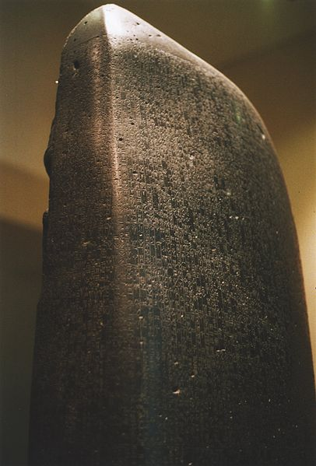
Code of Hammurabi (The Louvre, Paris)

Slide 8
Distinctive Israelite Law 2 : Theft
Torah
Hammurabi
Exodus 21:37, 22:1-3
“When a man steals an ox or a sheep…and it is found alive in [the robber’s] possession, he shall pay double.”
22: “If anyone is committing a robbery and is caught, then he shall be put to death.”

Slide 9
Distinctive Israelite Law 3 – Inherited Punishment
Torah
Hammurabi
Deuteronomy 24:16
“Children shall not be put to death for parents (sins) a person shall be put to death only for his own crime.”
209, 210: “If a man strike a free-born woman (upper class) so that she lose her unborn child, he shall pay ten shekels for her loss. If the woman die, his daughter shall be put to death.”

Slide 10
Exodus Book of the Covenant vs. Code of Hammurabi
Who Establishes Law?
Compensation for Murder?
Death for Stealing?
Are Money and Human Life Interchangeable?
Can Husband Spare Adulterous Wife?
Judicial Inherited Punishment?

Slide 11
Leviticus, Numbers and Deuteronomy
Leviticus – Laws of Sacrifices, Priests, Dietary Laws (11), Forbidden Unions (18 and 20), Holidays – 3 Pilgrimage + 2 Penitential (23)
Leviticus 19:18 “Love Your Neighbor as Yourself”
Numbers – Israelite Sins in the Dessert – Moses Denied Entry into the Promised Land
Deuteronomy 6: “Hear (“shema”) O’ Israel the Lord (YHWH) is our God (ELOHIM), the Lord Alone…You shall Love the Lord your God.”

